Slide 1

Leverage IT to reduce cost
Latest practices to reduce cost of procurement by using auction portals
By:
Vinaya Varma
Vice President
mjunction services limited
Conference on Procurement Governance
Thursday, August 07, 2014

Slide 2
Today, reverse auctions are widely used to reduce cost of procurement
  100% of the Fortune 500 companies are using reverse auctions
  Several Public Sector Organizations & Private sector organizations, in India are using reverse auctions
  It has helped them to achieve reduced cost of procurement, reduced cycle time, & increased transparency in procurement transactions.
  The suppliers have found auctions to be providing transparency, reduced cycle time & insights into market prices
Conference on Procurement Governance
Thursday, August 07, 2014

Slide 3
Let’s understand reverse auctions
  It is a competitive bidding event, in which suppliers place their decreasing price bids, in real-time, on a web based application
  “The suppliers are provided a login & password by the auction portal, using which they login on the website and place their bids.
  They can also view the status of the auction, details of the market, and their competitive position in the market.
  Auctions generally occur in a compressed time frame from 30 minutes to a couple of hours
Conference on Procurement Governance
Thursday, August 07, 2014

Slide 4
Typical
Objections
However, many organizations are still yet to explore auctions
  “ Our suppliers do not like reverse auctions. They will never participate in auctions”
  “ What we buy, cannot be bought through auctions”
  “ We get better savings by negotiating with our suppliers across the table”
  “ Auctions are not strategic and do not facilitate long term relationship with our suppliers”
Conference on Procurement Governance
Thursday, August 07, 2014

Slide 5
Reverse auctions should ideally be used for the “Leverage” spend categories
High
Kraljic Portfolio Purchasing Model:
Leverage Items | Strategic Items
Large volume purchases Unit cost important Substitutes available Many equivalent suppliers available | Unique specifications or value add Supplier technology critical Few suppliers available Difficult to substitute
Profit Impact
Non Critical Items | Bottleneck Items
Commodities Easy to find substitute products Many supplier available Limited Financial Impact | Unique Requirements Difficult to substitute Supplier’s knowledge , technology , assets or expertise critical
Supply Risk
Low
Low
High
… However, it has also been used effectively in all categories, except for “Bottleneck”
Conference on Procurement Governance
Thursday, August 07, 2014

Slide 6
Ideally, reverse auctions work best when certain criterions are fulfilled
Factors
Standard Criterion
Product Specifications
Simple & well defined
Structure of Supply base
Large & competitive
Size of Purchase
Medium or high
Savings Opportunity
High potential
Strategic Importance
Low
Conference on Procurement Governance
Thursday, August 07, 2014

Slide 7
However, with gathering of experience, the current practices are
Current
Practicse
Factors
Product Specifications
“ If you can specify it you can auction it “
Structure of Supply base
If you have more than 1 supplier, you can go ahead
Size of Purchase
Typically Above Rs 5 lacs. Have also done for Rs 2000 + crores buy
Savings Opportunity
Should be more than the cost of conduct of auction
Even strategic items have been procured through reverse auctions, as long as the supplier relationship is not strategic
Strategic Importance
Conference on Procurement Governance
Thursday, August 07, 2014

Slide 8
Critical Factors for success in reverse auctions
  Reverse auction must be preceded by a sound sourcing process
    Selection of suppliers, Framing of RFQ
    Preceded preferably by an e-RFx process
    Market Research – Target price
  Reverse Auction Strategy – Auction Type, Disclosure Rules, auto extension time, Bid decrement, Line item vs Lot bidding etc.
  Training & Support to Suppliers
    Sound Training on auction rules, Notification on event timings, call center support during the auction
  Highest Transparency, Ethical & legal standards
    No phantom bidding, no rabbits, no acceptance of offline private bids, no bird watching
    All suppliers every have the same unrestricted access to all relevant event information
  Evaluation of prices
    No evidence of bid rigging or cartel formation, Reasonability of prices received etc.
Conference on Procurement Governance
Thursday, August 07, 2014

Slide 9
Case
Study
1
e-Reverse Auction : Mobile Connection
Event Details:
Post Paid Mobile Connections | Event Date : 14.01.08
Strategy Adopted
The objective was to finalize post paid mobile connections for 4000 + executives
Three mobile service providers were shortlisted.
The rate plan was found to consist of two parts;
  a) Fixed (rent per month)
  b) Variable, ie charge per call
The buy strategy adopted comprised of 4 steps;
  Step 1: The variable fee structure was normalized & made uniform
  Step 2: Quotes were obtained for fixed part through online sealed bid
  Step 3: e- bidding on the fixed part
  Step 4: e-reverse auction on the fixed (monthly rental ) was conducted
Outcome Highlights :
A plan with zero rentals and a discount of Rs.75 on bill value per connection per month on the variable part.
Identified cost reduction- Rs 23 lacs per month
Conference on Procurement Governance
Thursday, August 07, 2014

Slide 10
Case
Study
2
e-Reverse Auction : Outbound Transportation
Event Details:
Outbound transportation of Pipes & Flat products | Event Date : 10.12.10
Strategy Adopted :
The objective was to finalize a Two-year contract for outbound transportation of pipes & flat products for SAIL RSP for 443 destinations
Value of the buy: Rs. 16 Crores
There were 17 transporters
Lots were created on the basis of Major Destinations while Category Slabs were created based on Non-Major destinations
The buy strategy adopted comprised of 5 stages;
  Stage 1: Online sealed bid stage across different category slabs
  Stage 2: Online price matching stage with L1 rate of each category slab
  Stage 3: Mass sealed bid stage across different category slabs
  Stage 4: Forward auction on discounts for each lot
  Stage 5: Online matching of highest discounts across each lot
Outcome Highlights:
Aggressive bidding, with as high as 196 bids for one of the destinations
Cycle Time: 4 working days. (Mandate receipt to price break up submission)
Conference on Procurement Governance
Thursday, August 07, 2014

Slide 11
Case
Study
3
e-Reverse Auction : Multi-attribute based reverse auction
Multi-attribute & Template based reverse auction is used when:-
  Multi parameters are to be considered to compute the effective price. In this case, the effective price is calculated on-line and displayed to the bidding customer for him/her to decide to place the bid directly through the template
  On-line auctions for cases where different bidding customers have different applicable tax structures, by creating bidding customer specific templates
  Enables the provision of template wise break-up for the respective lowest bid of each bidding customer
Conference on Procurement Governance
Thursday, August 07, 2014

Slide 12
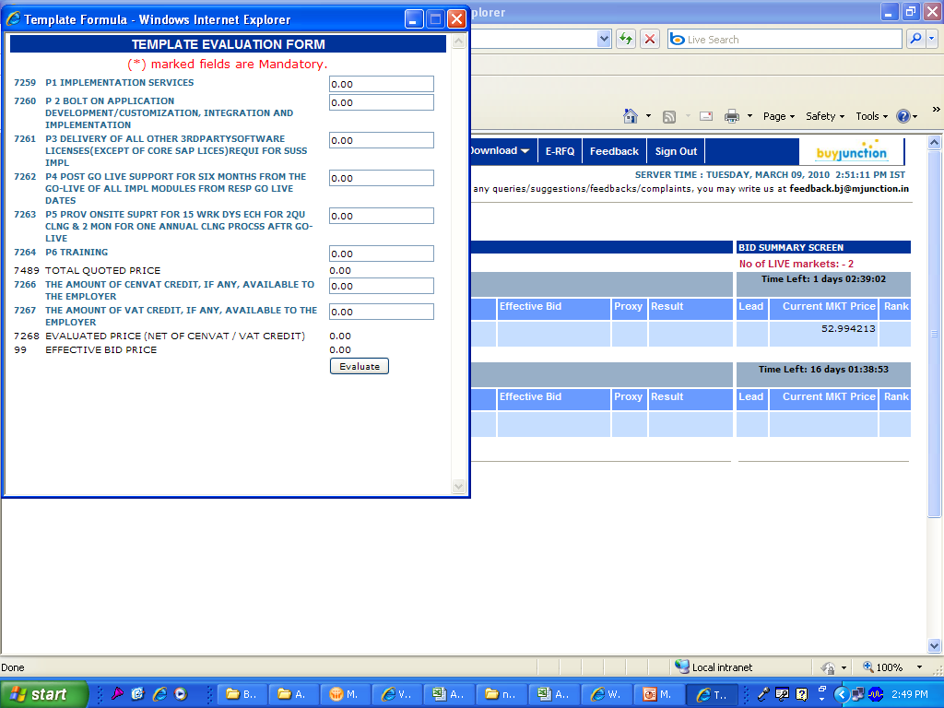


Case
Study
3
e-Reverse Auction : Template based Bidding
Vigilance Awareness Week 2012
Thursday, August 07, 2014

Slide 13

Case
Study
4
e-Reverse Auction : Graphite Electrode
Event Details:
Graphite Electrode for Induction furnace | Event Date : 09.03.2011
Strategy Adopted
The objective was to finalize supplier for Graphite Electrodes (GE) on “Total Cost of Ownership (TCO)” basis.
Nine Global manufacturers were shortlisted.
Three parameters (apart from price) identified towards evaluating TCO of GE:
  a) Yield (Consumption of GE per ton of steel produced)
  b) Performance and responsiveness of vendors
  c) Commercial parameters
The buy strategy adopted comprised of 4 steps;
  Step 1: End user survey conducted for scoring the vendors’ performance.
  Step 2: Loading factor was decided as a function of vendors’ score.
  Step 3: Loading factor was decided based on commercial evaluation.
  Step 4: Vendors were asked to quote guaranteed yield (linked to penalty)
  Step 5: e- bidding on TCO basis, i.e, TCO =
$$f\left(Price, Loading factors, Yield\right)$$
Outcome Highlights :
Identified cost reduction- $ 0.85 million per year (4.9%)
Guaranteed Yield.
Conference on Procurement Governance
Thursday, August 07, 2014

Slide 14
e-Reverse Auction : MJ experience
  4,000 nos. of e-reverse auctions conducted during FY’14
  Rs 8,000 crores of value of procurement through e-reverse auctions
  Types of e-reverse auction strategies used : 17 different types
  Types of Buys: Goods, services, contracts, projects etc
Conference on Procurement Governance
Thursday, August 07, 2014

Slide 15


e-Reverse Auction : MJ experience
MRO/ Engineering
Services Hire
Logistics, hiring of vehicle
(car, trucks, dumpers etc),freight
forwarding etc.
Mechanical consumables:
Ex: pumps, motors, pipes
& fittings, belts, jigs, safety eqpmt.
Telecom, IT (S/W),
Mobile Service, Data Centres,
consulting etc.
Electrical consumables:
Ex: Switchgears, panels, cables
lamps & fittings,ACB,transformer
Rate contracts – (Cleaning,
housekeeping, civil jobs,
electrical jobs, maintenance &
Repair jobs etc)
General consumables:
Ex: Chemicals, packaging,
stationery, packaging, lube
In-plant, project site Mechanical
& electrical maintenance services
Maintenance and OEM
Spares of machines &
Capital goods
Conference on Procurement Governance
Thursday, August 07, 2014

Slide 16
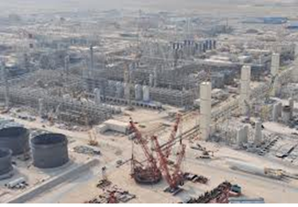
e-Reverse Auction : MJ experience
Raw Material/Chemicals/ Minerals
Capital Buy
Fuel Ex-CPC, Lam Coke, Coal (thermal, steam, ROM), semi burnt paddy husk
Capital equipment:
Ex: Lifts, cranes, Machinery,
vehicles
Chemicals (Sulphuric acid, common salt, tarfelt, magnetite, quartzite, flourspar, lime)
Project materials:
Ex: steel, cement, cables,
Transmission Equipment
Natural graphite, sea water magnesia, CS lye & flakes, burnt lime, sand, calcined bauxite
Project contracts:
EPC contracts, Turn Key,
Non Turn Key etc
Metal (Manganese, nickel, iron pyrite & pallet), graphite flakes
Office equipments:
Furniture, Paper, A/C,
Computers, Anti-virus etc
Aluminium (Powder, shots, notch bar, wires etc)
Conference on Procurement Governance
Thursday, August 07, 2014

Slide 17













































mjunction’s Footprint the industries we work with
Metal & Mining Sector
Services Sector
Energy & Utilities Sector
Consumer Sector

Slide 18








MJ Experience in Implementation of e-Procurement/ e-auctions for PSUs

Slide 19
Conclusion
  E-auction tools & strategies have now evolved to support procurement of more complex goods & services ( where several parameters, may influence the award decision).
  E- reverse auction must be preceded by a sound sourcing process in order to deliver the best benefits.
  The chosen auction portal must have the requisite credibility to give confidence to the suppliers.
  Organizations that have succeeded in reverse auction have given a lot of focus on the CSFs
Conference on Procurement Governance
Thursday, August 07, 2014

Slide 20
  Thank You
  vinaya.varma@mjunction.in

