Slide 1

Public- Private alignment in PPP
A presentation by Mukesh Arya
Red Flag Conference on Procurement Governance
8-9 Aug 2014, Gurgaon

Slide 2



Three-legged race
Public- Private partnership

Slide 3
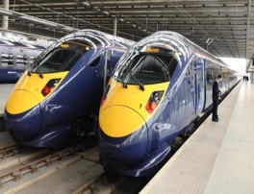
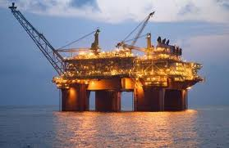
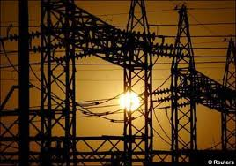
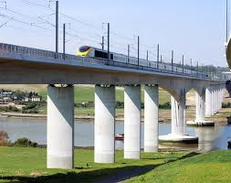

Agenda
Overview of PPP projects
Major issues in PPP Projects
Recognizing concerns and PPP practices
Accountability issues

Slide 4
What is PPP?
It is an arrangement between a government/Statutory entity/government owned entity on the one hand and a private entity on the other for the provision of public assets and/or public services, through investments being made and/or management being undertaken by the private sector entity, for a specified period of time, where there is well defined allocation of risk between the private sector and the public entity, and the private entity receives performance-linked payments that conform (or are benchmarked) to specified and pre-determined criteria.”

Slide 5

PPP mode of Procurement
Telecom
Power
Airports
Ports
A strong vehicle to carry the partnership between private and public sector in many sectors, notably, Highways, Railways, Ports, Airports, Telecom, power and many other sectors.
Highways

Slide 6
Overview of
Public Private Partnership Projects
Solicited proposals
Unsolicited Proposals
Transport infrastructure
Power sector
Environmental
“MDG PPPs”
Tourism, convention
partnership
BOT
LOT
BOOT
DBFO
Operation concessions
Joint ventures
[Govt+Private], [Govt+PSU+Private], [PSU+Private],
[Body incorporate+Private], [SPV]
Asset ownership
Capital invested
Risks assumed
Technical expertise
Duration of the Project
Accountability issues
public services
Value for money
Return on Investment
commercial success
fair dealing

Slide 7
Major issues in PPP projects
Selection process
RFP/ Tendering process
Negotiation and Contracting stage
Construction stage
Operation

Slide 8
Recognizing the concerns and PPP practices
Selection
Tendering
Negotiation
Construction
Operation
Eligibility conditions
Conflicts of interest issues
Evaluation criteria
Transparency issues
Procurement issues
Substandard quality of work
Misuse of “land” concession
Padding of costs
User charges
Maintenance issues
Conflicts of interest issues
Total Project cost verification
Revenue sharing issues
Residual assets valuation
Non-transparent negotiations
Kickbacks and corruption
Conflicts of interest issues
Modifications in terms of contract
“selection” of project itself, particularly if unsolicited
Environmental issues
Conflicts of interest issues
Formulation of project

Slide 9
Accountability issues
Who raises issues?
Reports go to whom?
Who conducts investigation?
Who takes action?
Who is Accountable?
WBM benefits all stakeholders. Ideally, each partner must have a whistle blower facility.
Additionally, “Regulatory Body” must also have the facility to perform the role of the last resort.
Role of CVC , CBI and CAG.
Independent Engineer and Independent Auditor may need well designed charter.
Engaging civil society with the project results in accountability
Partners in PPP may be either victims or perpetrators of fraud and corruption.
Remedial measures must find place in the charter of regulatory body.
Regulatory authority
Respective board of directors (PSU, Pvt company)
Any other as decided beforehand

Slide 10
Some examples of PPP project issues
Bangalore Mysore Infrastructure Corridor (BMIC) - land related litigations
  The Consortium, Nandi Infrastructure Corridor Enterprises (NICE), comprises the Kalyani Group of Companies, VHB International LTD. and SAB International LTD.
  Agreement: NICE to return to the government 14,255.7 acres of land of the total 20,193 acres required for the project after the toll collection period of 30 years. But, the quantum of land to be returned had been “illegally” reduced in the government records to 11,966 acres resulting in a “loot” equivalent of Rs. 30,000 crore. (HD Deve Gowda charges)
  The land for the project increased even after reducing the number of townships from seven to five. The compensation for land was fixed at the 1995 market price but distributed in 2002.

Slide 11
Some examples of PPP project issues
Bengaluru International Airport (BIA) - sub-standard
First Greenfield airport - Airport Authority of India, Karnataka State Industrial Investment & Development Corporation, GVK 43%, other 31% private promoters.
Issues: HAL airport closed – traffic increased and could not be managed by BIA

Slide 12
Some examples of PPP project issues
Commonwealth Games Village, New Delhi
DDA and Emmar MGF to construct residential complex for Commonwealth Games. Single qualified bidder
Issues: inordinate delay, FAR exceeded, quality concerns, funding by DDA to bail out Emmar MGF’s financial standing, buy back of flats at commercial rates, post completion waiver of LDs

Slide 13
Some interesting provisions of PPP
Viability Gap funding – Yamuna expressway – additional land for development
“to ensure Free flow of traffic” on expressway - Delhi-Gurgaon Super Connectivity Limited ( DGSCL)

Slide 14

Thank you
A presentation by
Mukesh Arya
B.Com (Hons), LL.B., AICWA, CIA, CFE, IA&AS (R)
Managing Director & CEO
Red Flag Oversight Consultancy Services P Ltd
Gurgaon 122018
Ph: +91-124-49 22 999
mukesharya@ethicscall.net
mukesharya@myredflag.org

